Slide 1
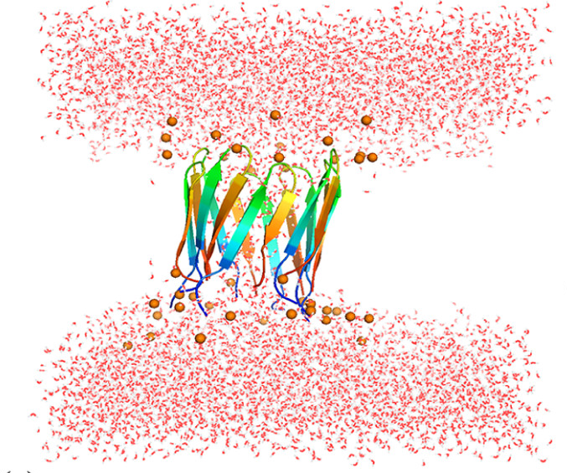
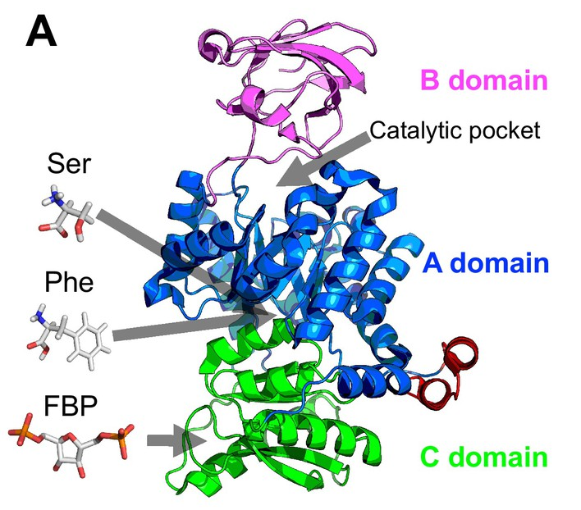
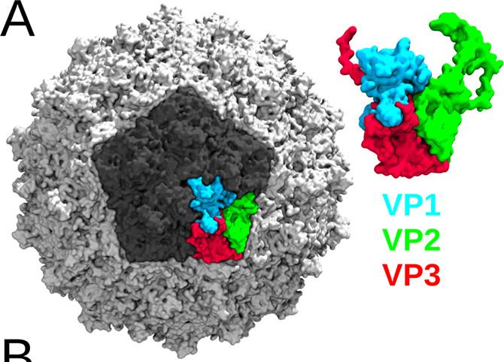
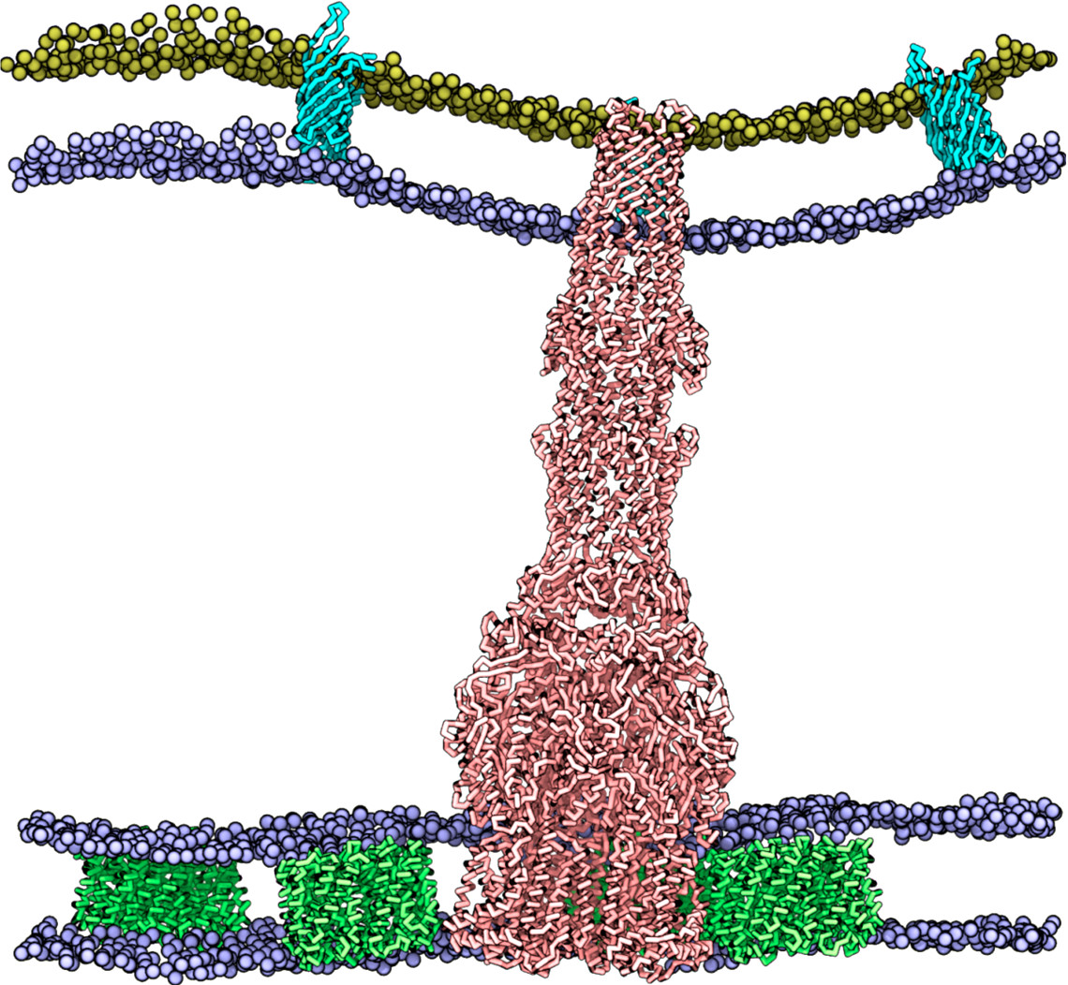
Description | Representative force fields (and limitations) |  | Examples
QM/MM | various | up to 100 QM atoms < 10 ns
POLARISABLE ALL-ATOMS | AMOEBA AMBER ff02 -CHARMM | Sizes as in All-atoms < 100 ns up to 100 ns up to 100-500 ns
ALL-ATOMS | CHARMM AMBER OPLS | 20 nm side up to 1 μs
UNITED ATOMS | GROMOS OPLS | 20 nm side up to 1 μs
POLARISABLE COARSE GRAIN | ELBA | 20-30 nm side up to 1-5 μs
COARSE GRAIN | SIRAH MARTINI | 20-30 nm - 10 μs 50 nm - 1-10 μs
COARSE GRAIN + MEAN FIELD | OCCAM | 20-30 nm side up to 10 μs
IMPLICIT SOLVENT | approach GB approach | various sizes up to 100 nm and 10 μs
Drude
SPEED ACCURACY
SASA

